Slide 1
Indian Ocean Tuna Ltd. (IOT)

Slide 2
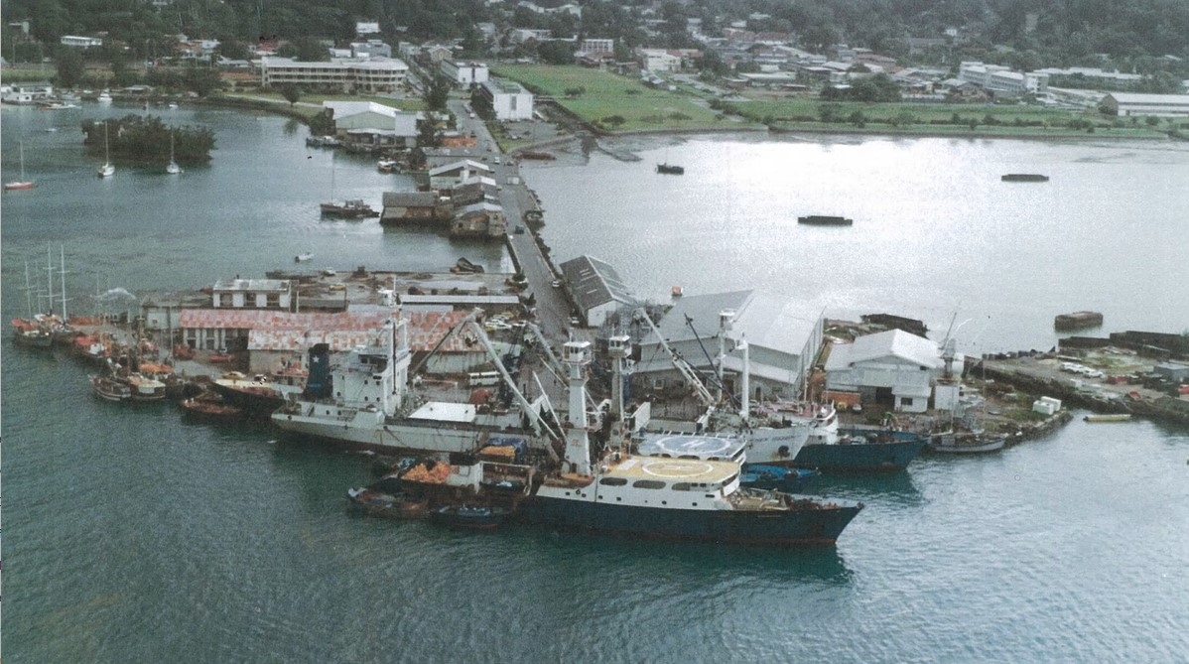
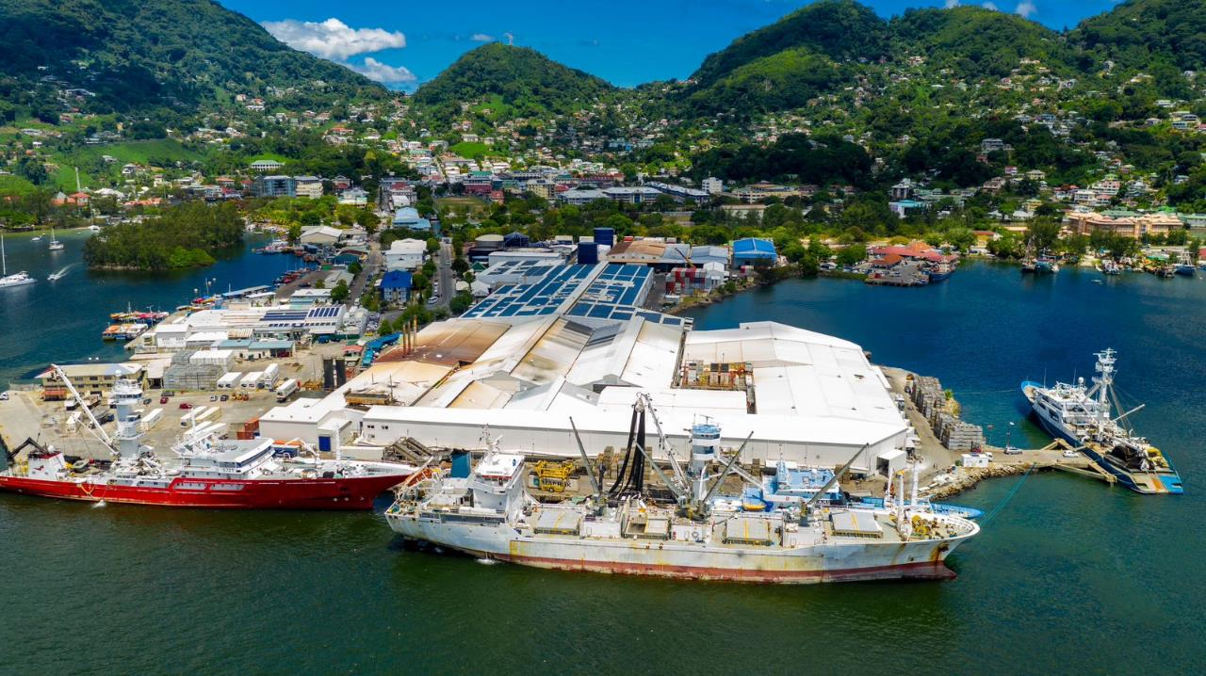
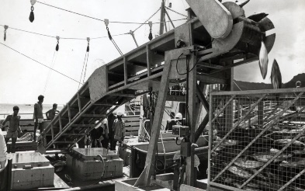
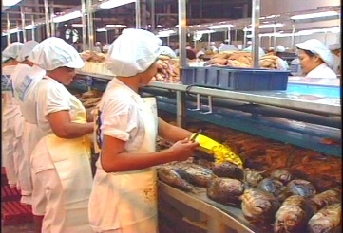
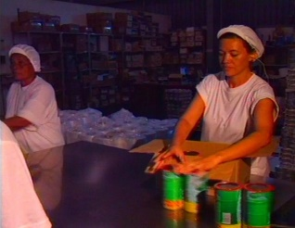
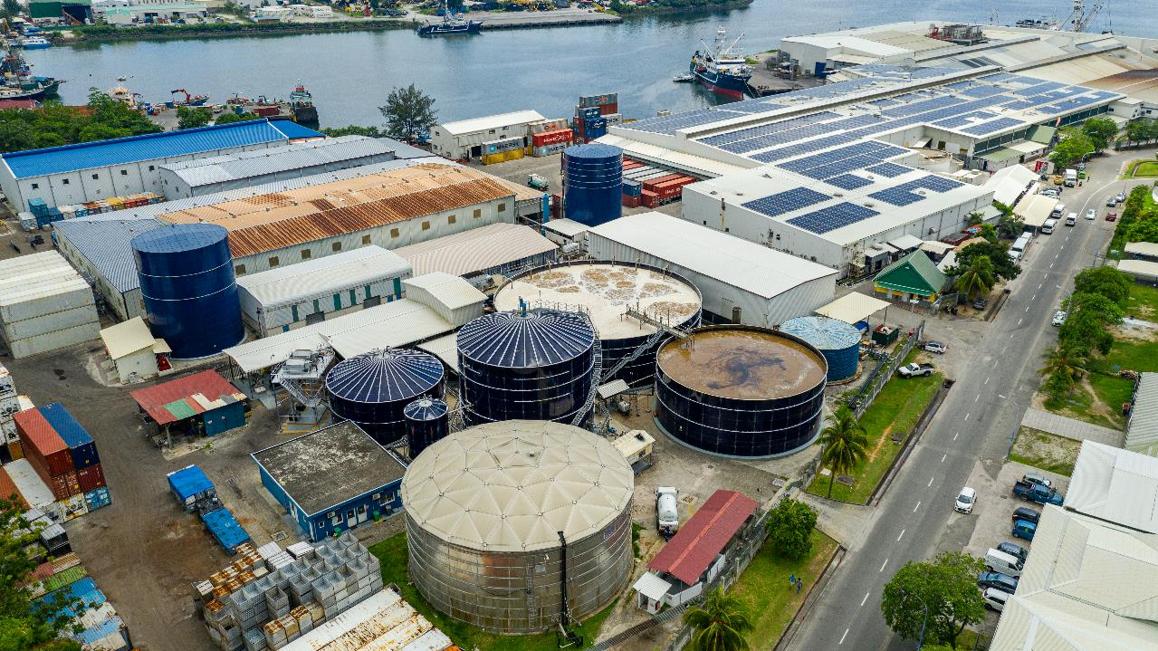
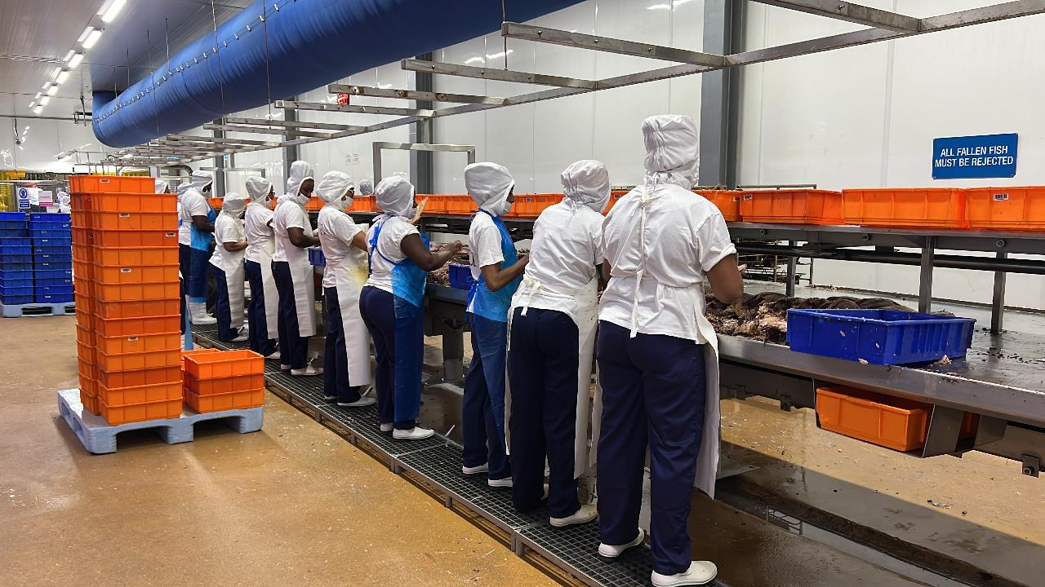
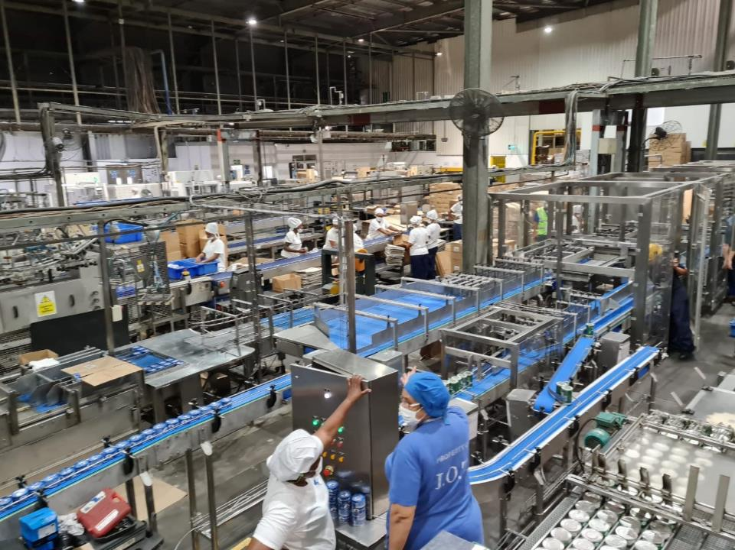
Iot before and now
► IOT originally denominated Conserveries Océan Indien (COI) was built by Government of Seychelles (GOS) in the year 1987 and operated by GOS until 1995 with approximately 900 employees and 50MT/Day.
► Operating with estimated 1,750 employees, multiculture of 15 nationalities. IOT, owned 40% by GOS, is currently the 3rd largest tuna factory in Thai Union Group processing 350MT/day.

Slide 3
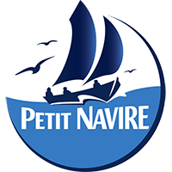
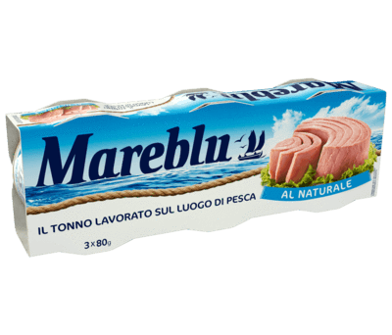
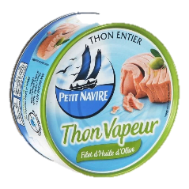
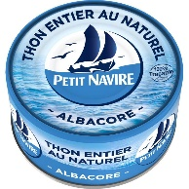
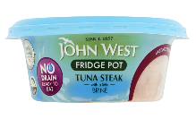
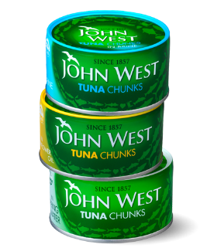
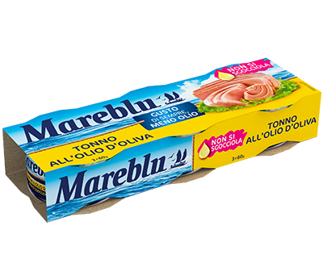
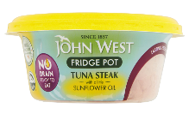
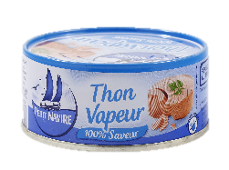
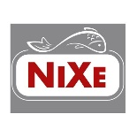
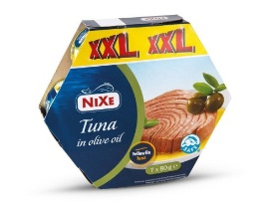
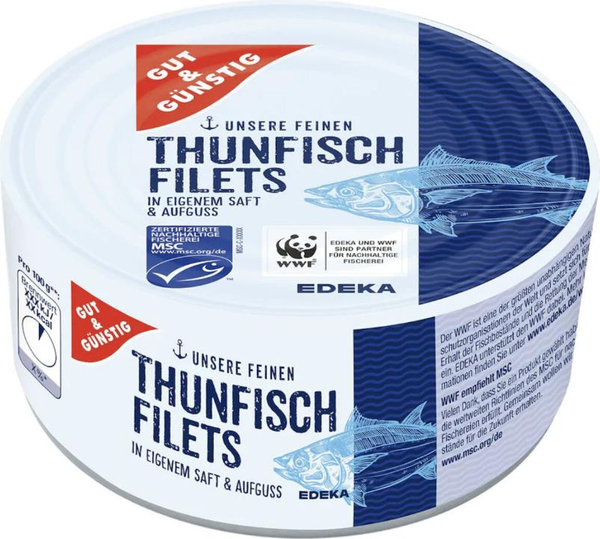
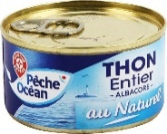
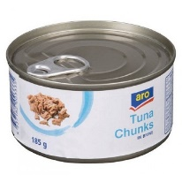
Canned tuna products for leading brands in europe
Thai Union Group Brands
Market leader in France
Market leader in UK
Number 3 in Italy
Private Label Brands
Local Brands

Slide 4
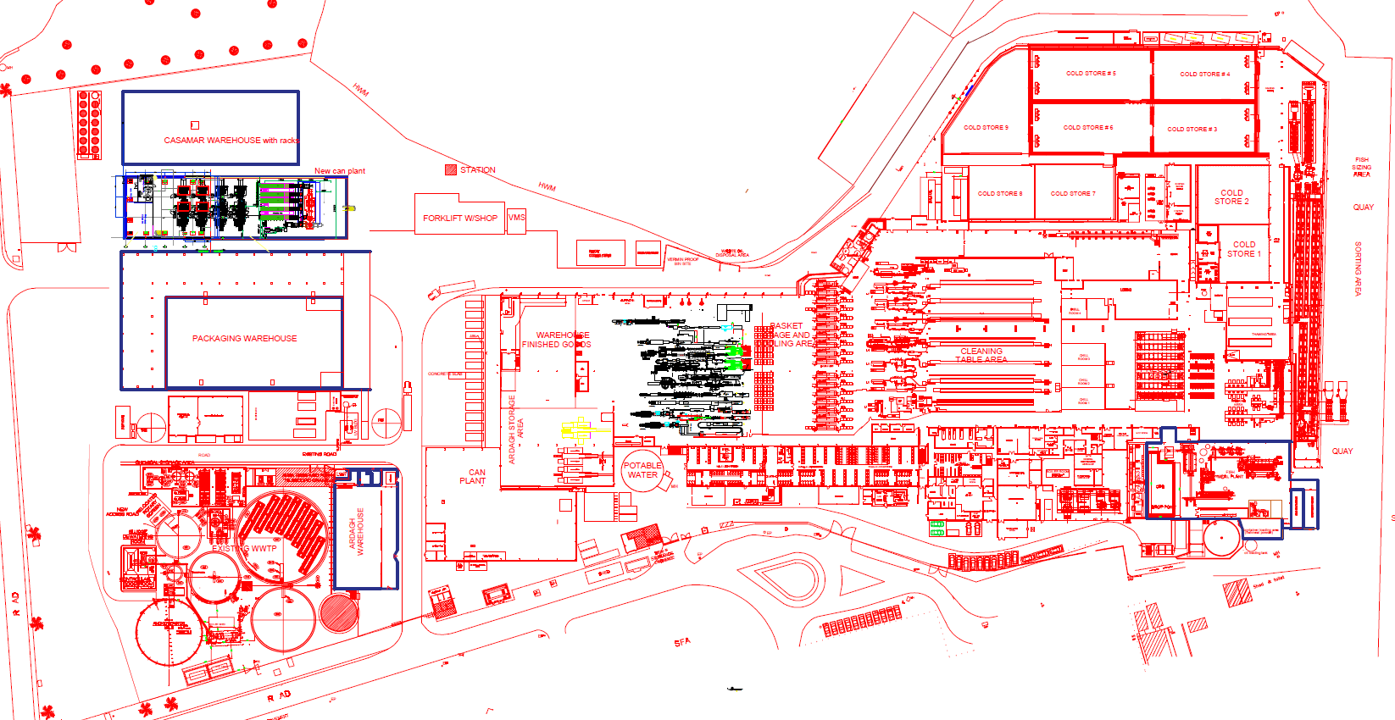
Cans 300M
CS 5.000
FG 42.000
TUNA 65.000
SEYCHELLES
IOT
HC 1.750
W 1.400
WW 1.400
FM 5.500

Slide 5
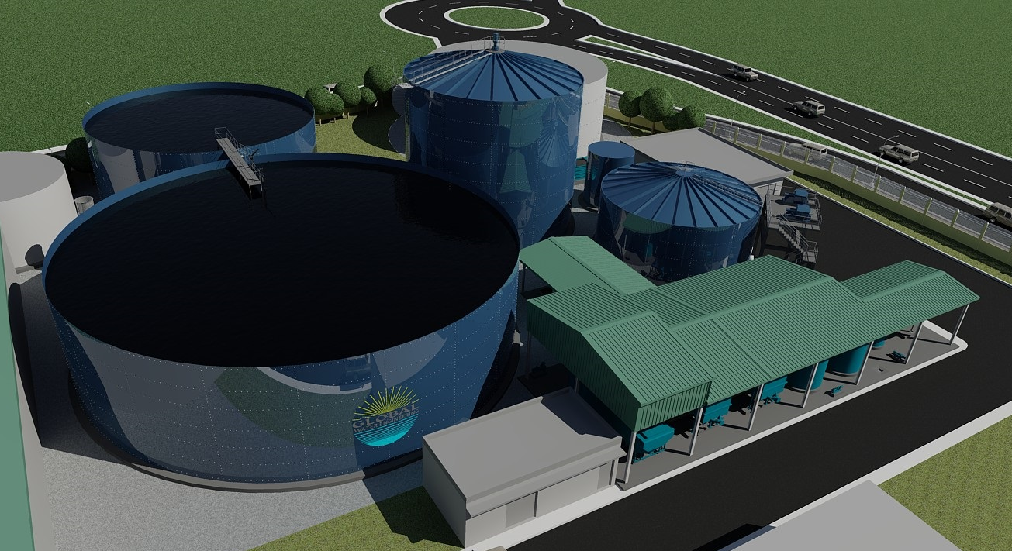
Waste Water Treatment plant & Bio Gas production
Sludge Storage
Biogas flare
Anoxic tank
Sludge digester
Equalization tank
Airation tank
Primary & Secondary DAFs

Slide 6
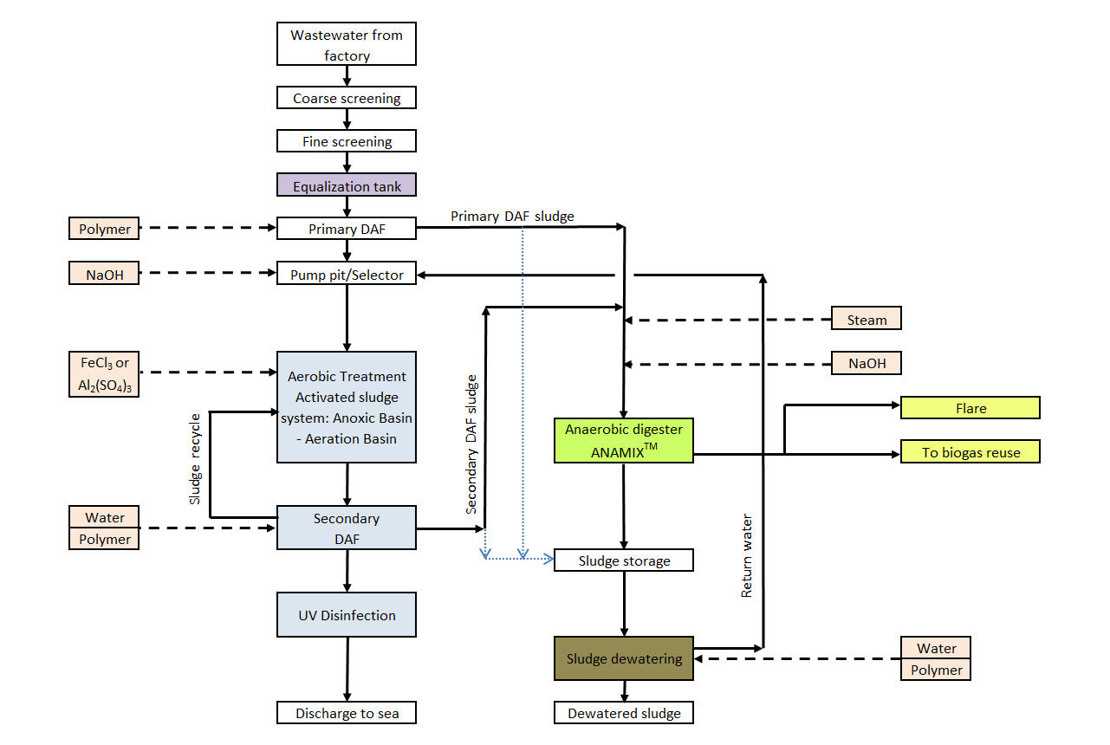
Process flow diagram
Sluge generated | 12-15 T/day | 2000T/year
Biogas generated | 2000Nm³
Water content | 85%
Sludge incinerator to be installed & operational end March 2025
To Landfill

