Slide 1
INTELLECTUAL PROPERTY
Dr Nitin Gopaul
Research Coordinator
Mauritius Research and Innovation Council

Slide 2
INTELLECTUAL PROPERTY
LITERARY AND ARTISTIC PROPERTY
INDUSTRIAL PROPERTY
Copyright
Related rights
Performers
Phonogram producers
Video producers
Communication companies
Audiovisual
Press publishers
Sui generis rights for producers
of databases
Rights for technical or industrial innovations
Rights relating to distinctive rights
Designs
Patents
Semi-conductor topologies
Plant varieties
Trademarks of products or services Geographical indications
Recognition of personal creative contributions
Protection of investments

Slide 3
LEGAL FRAMEWORK OF INTELLECTUAL PROPERTY IN THE REGION
Existing legislation
Comoros
Madagascar
Mauritius
Seychelles
Patents
Industrial Designs/Models
Trademarks
Copyright & related rights

Slide 4
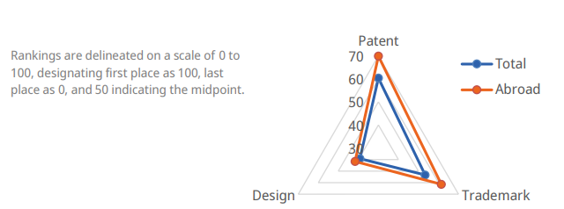
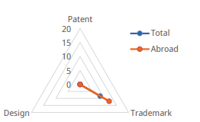
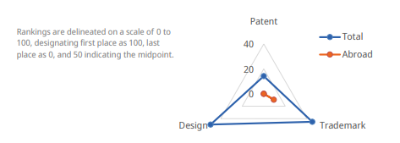
INTELLECTUAL PROPERTY STATISTICAL PROFILE IN THE REGION
Comoros
Mauritius
Madagascar
Seychelles

Slide 5
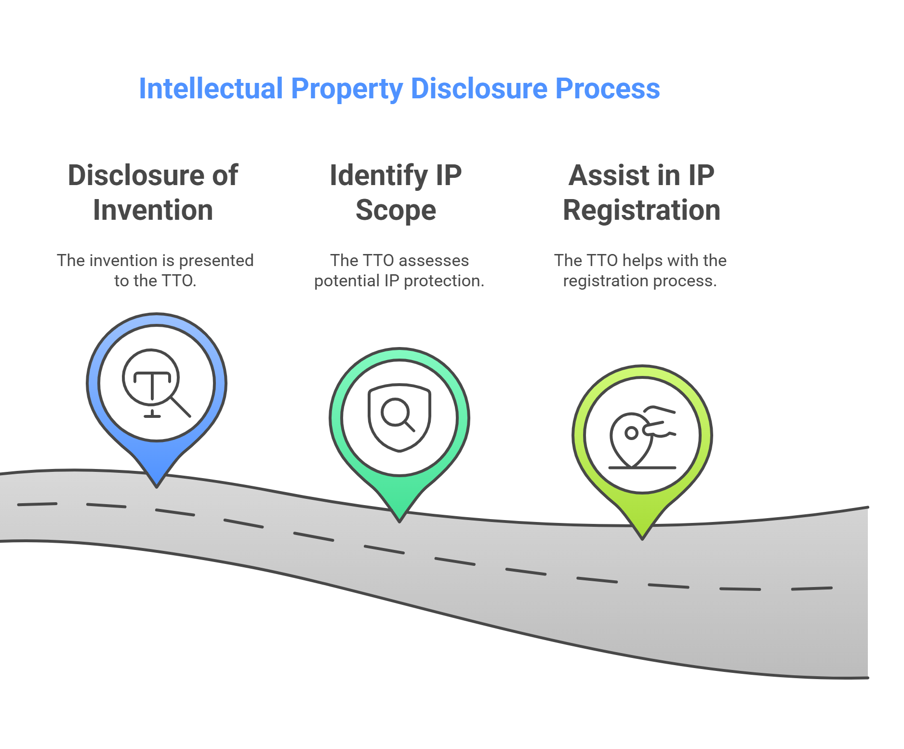
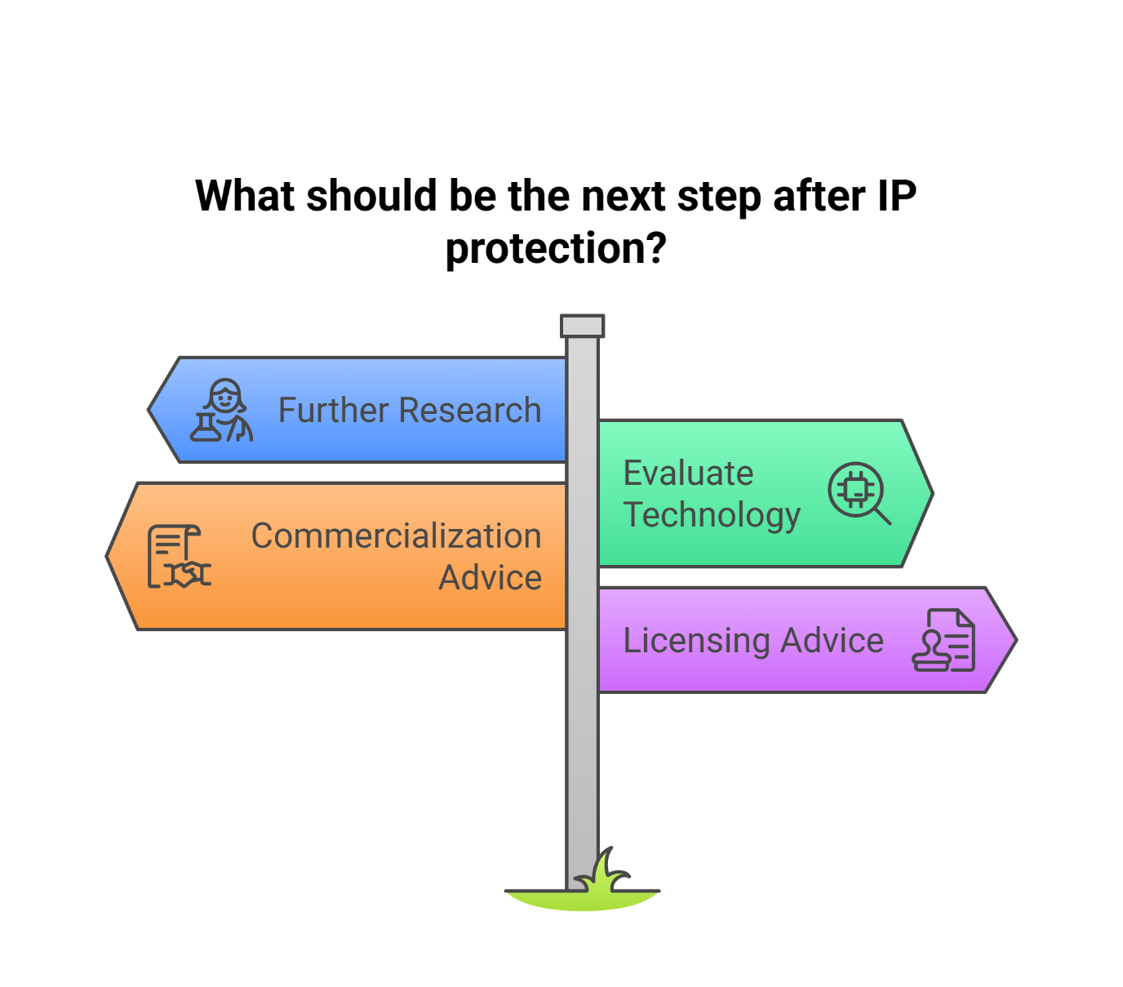
DISCLOSURE OF INVENTION

Slide 6
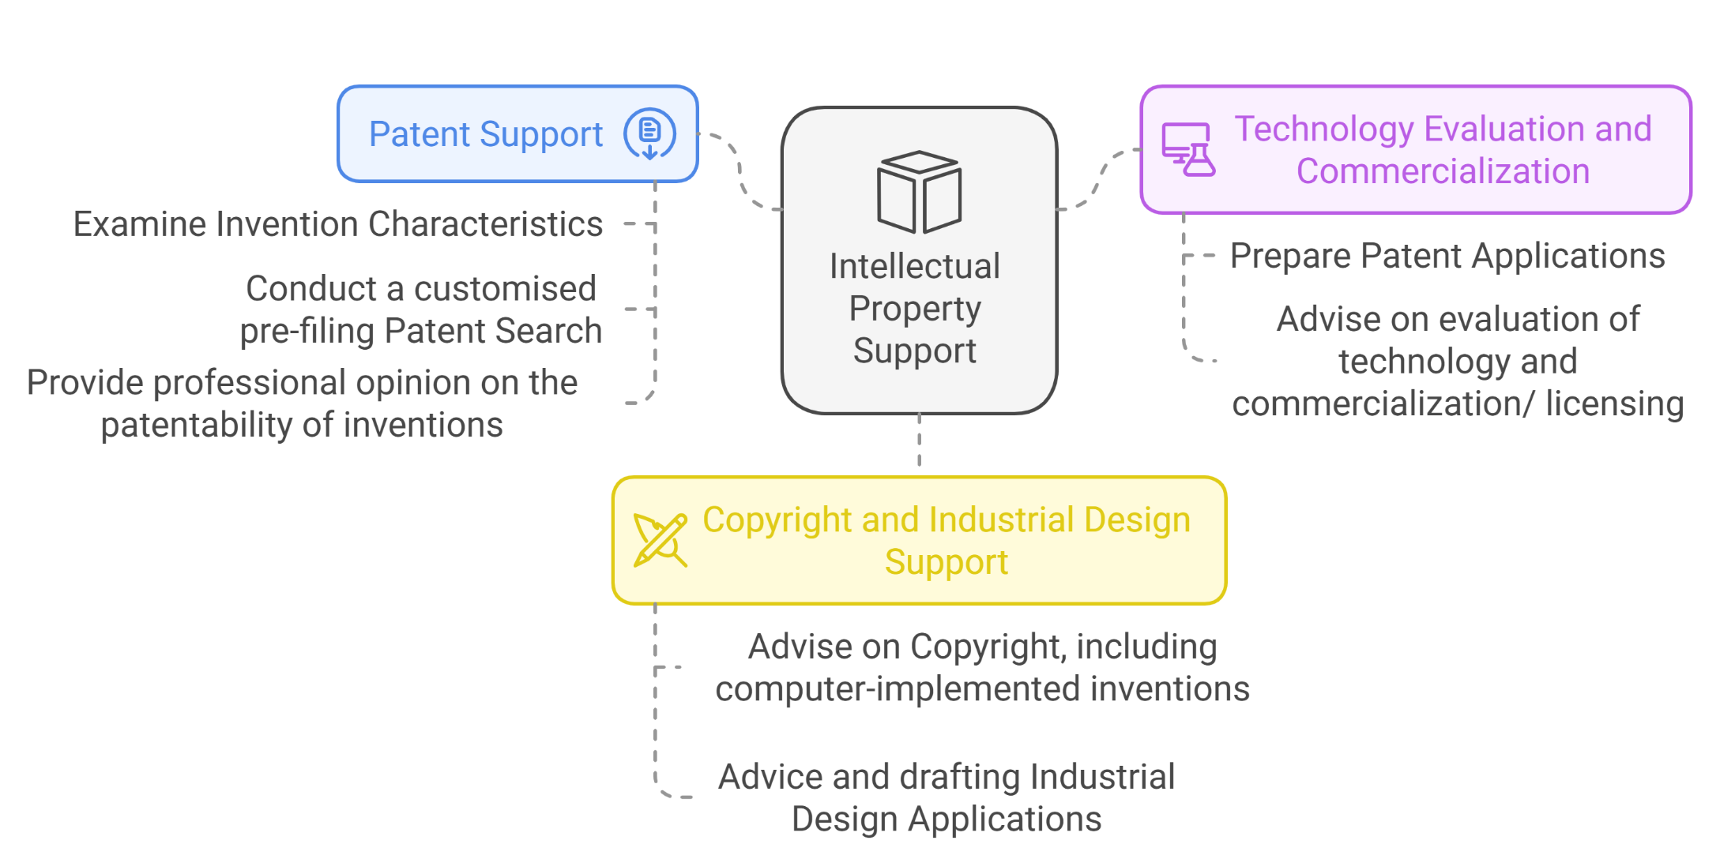
INTELLECTUAL PROPERTY SUPPORT

Slide 7
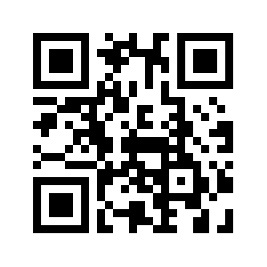
6th Floor, Ebene Heights 34, Cybercity Ebene 72201, Mauritius
(230) 465 1235
(230) 465 1239
https://www.mric.mu/
tto@mric.mu

Slide 8
Thank you for your attention !

